Slide 1
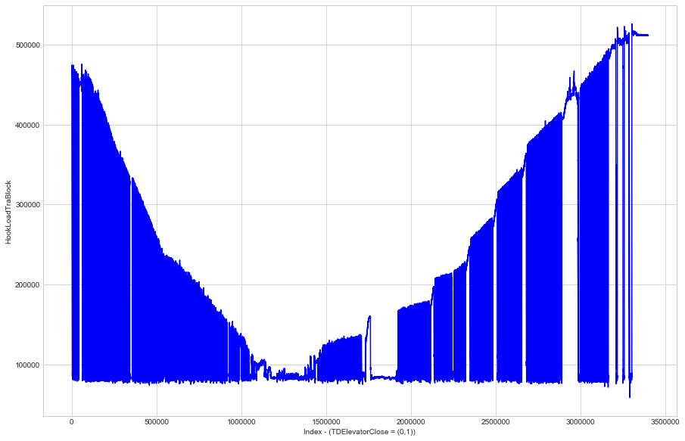
Identify Iceberg Drilling Sequence
Red curve (Input): HookLoadTraBlock;
Blue line (Output):
- Top Drive Close = 1 (In drilling process);
- Top Drive Close = 0 (Not in drilling process);
Accuracy:
- Without my algorithm: 60%
- With my algorithm: 99%!

Slide 2
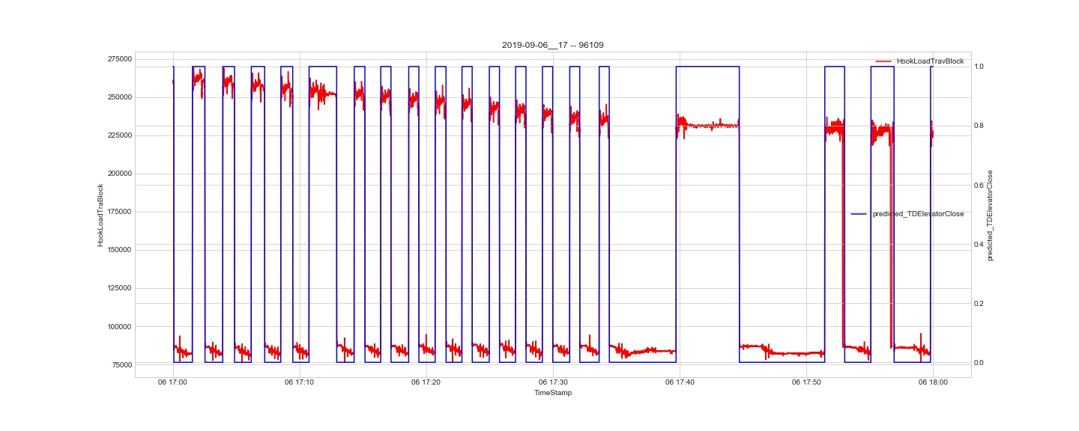
Result

Slide 3
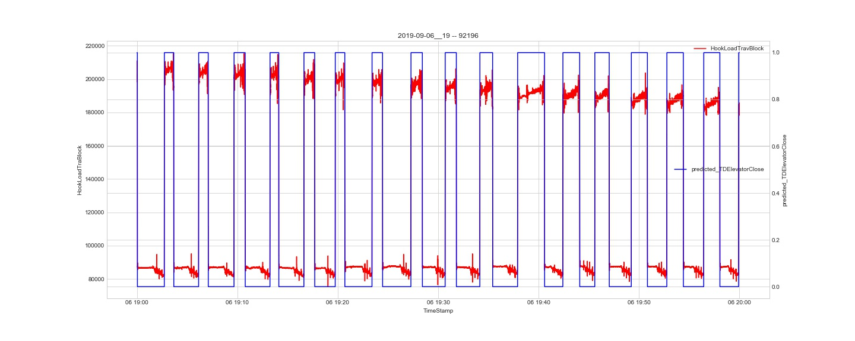
Result

Slide 4
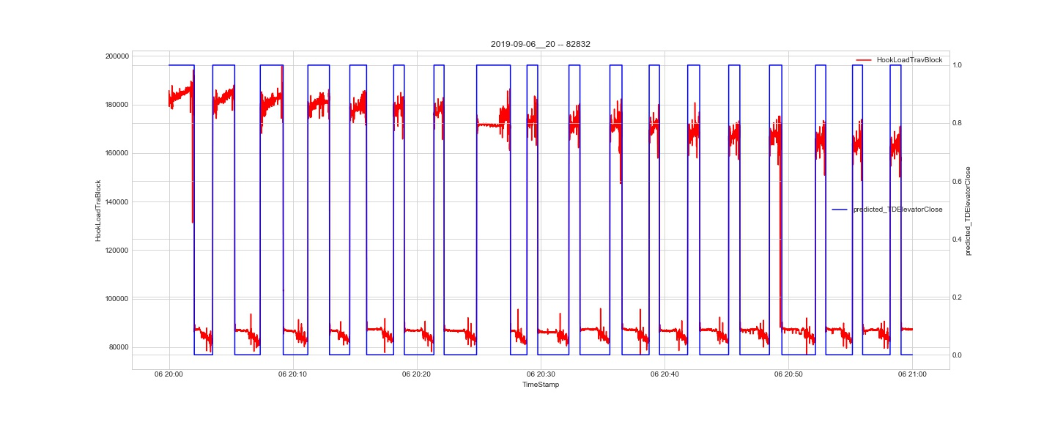
Result

Slide 5
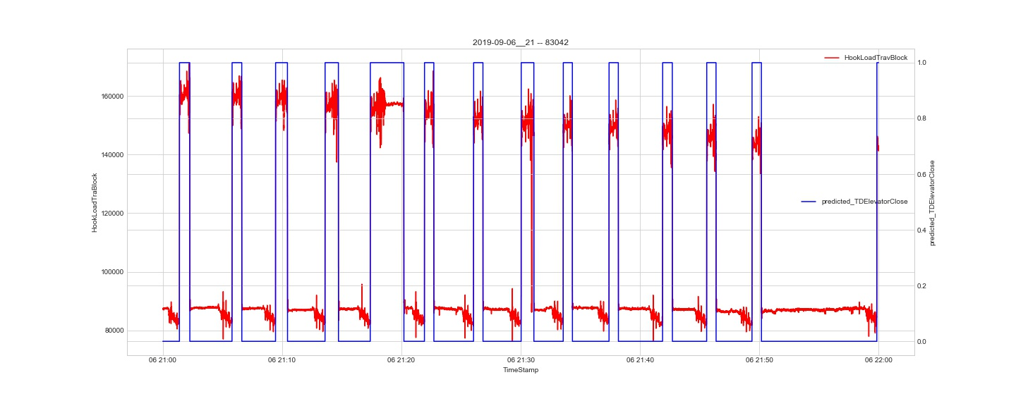
Result

Slide 6
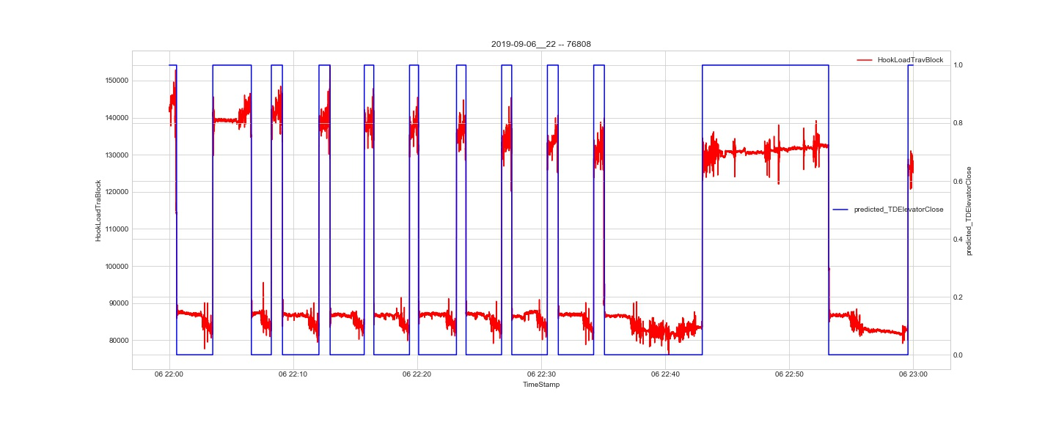
Result

Slide 7
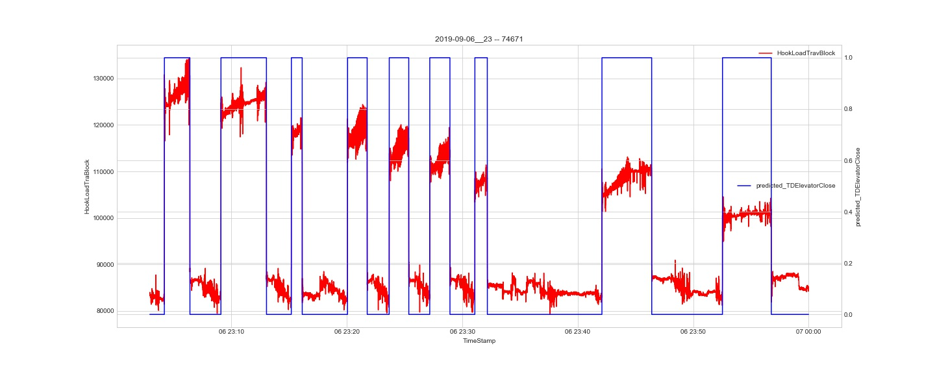
Result

Slide 8
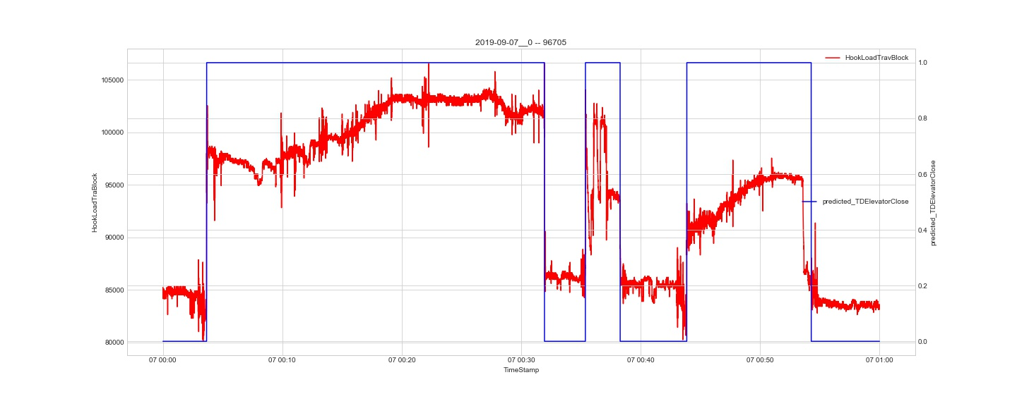
Result

Slide 9
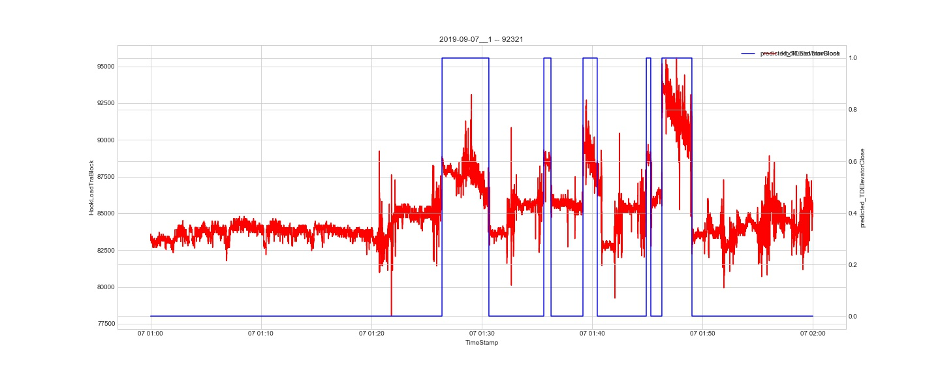
Result

Slide 10
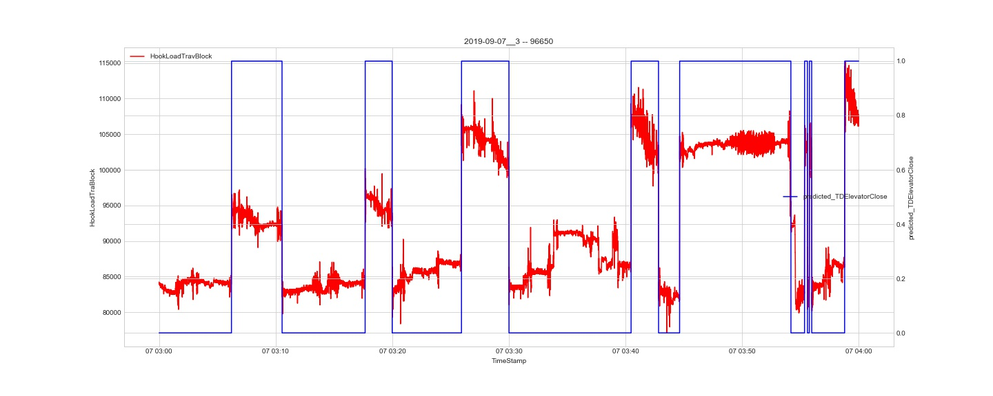
Result

Slide 11
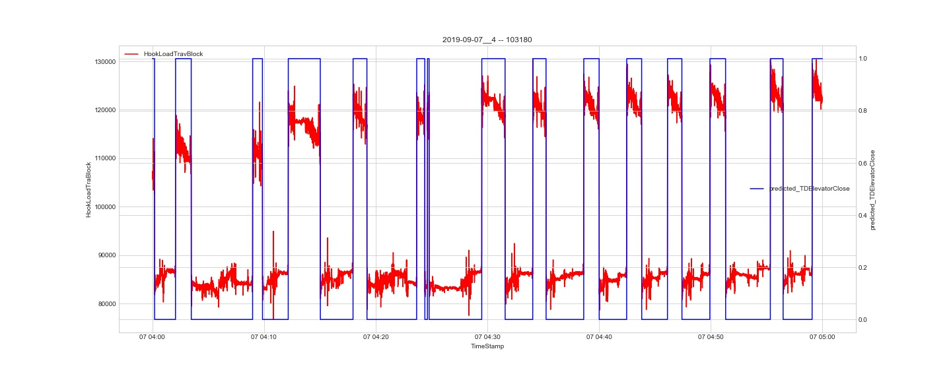
Result

Slide 12
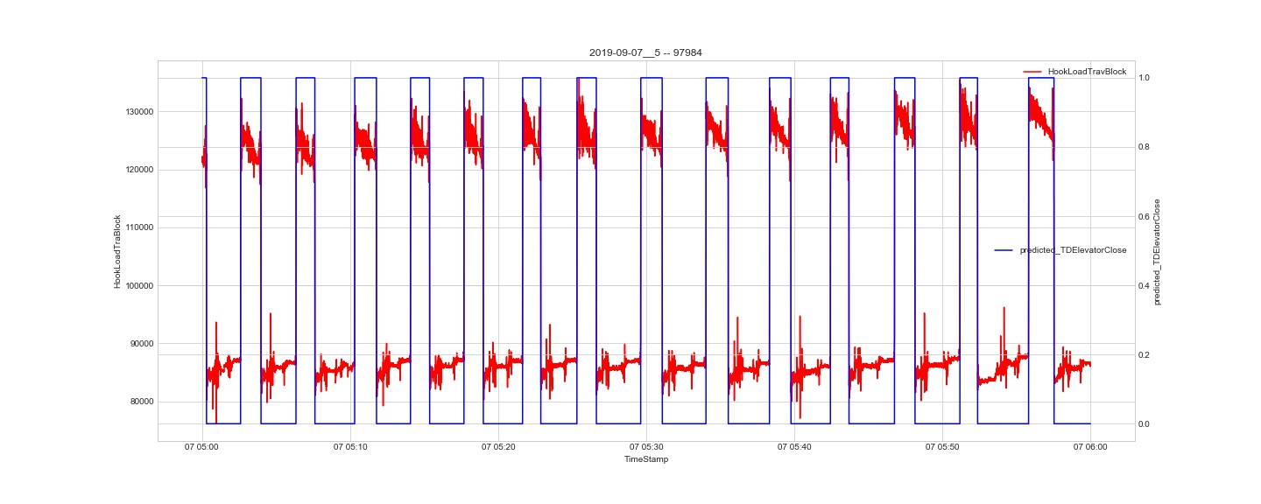
Result

Slide 13
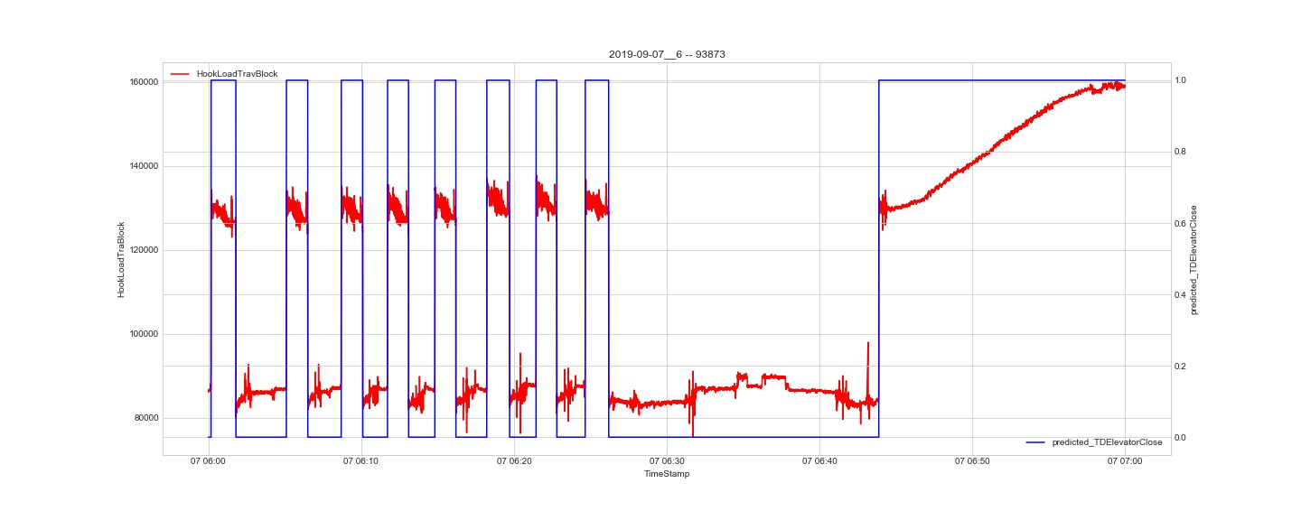
Result

Slide 14
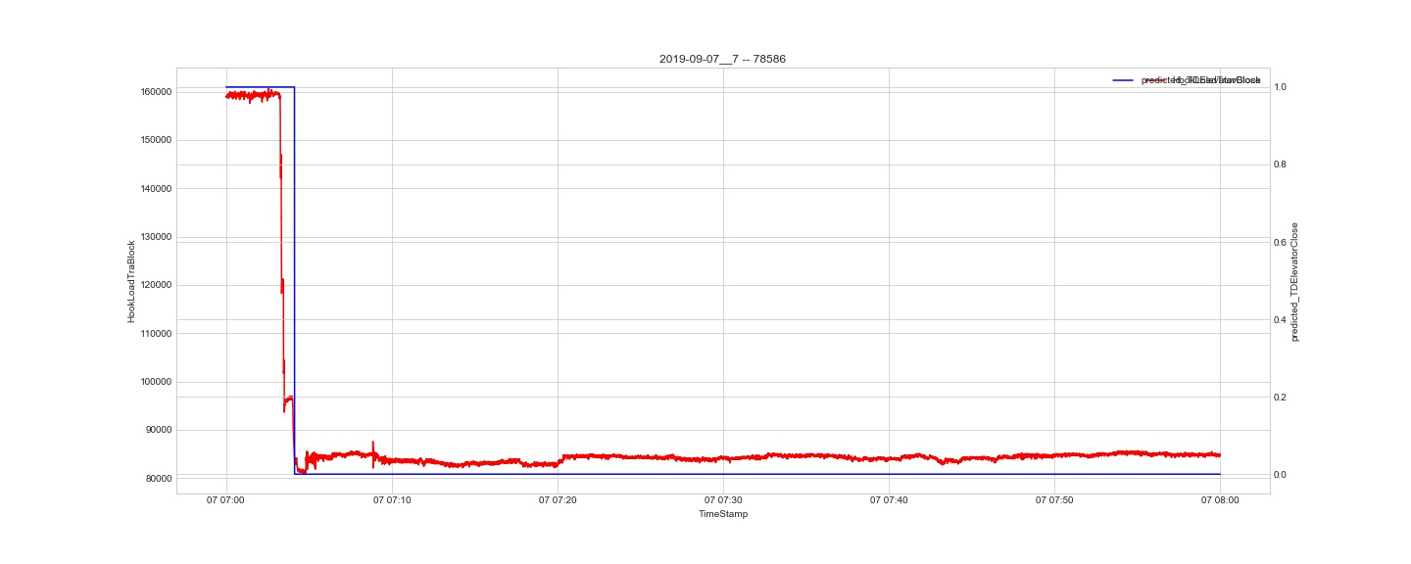
Result

Slide 15
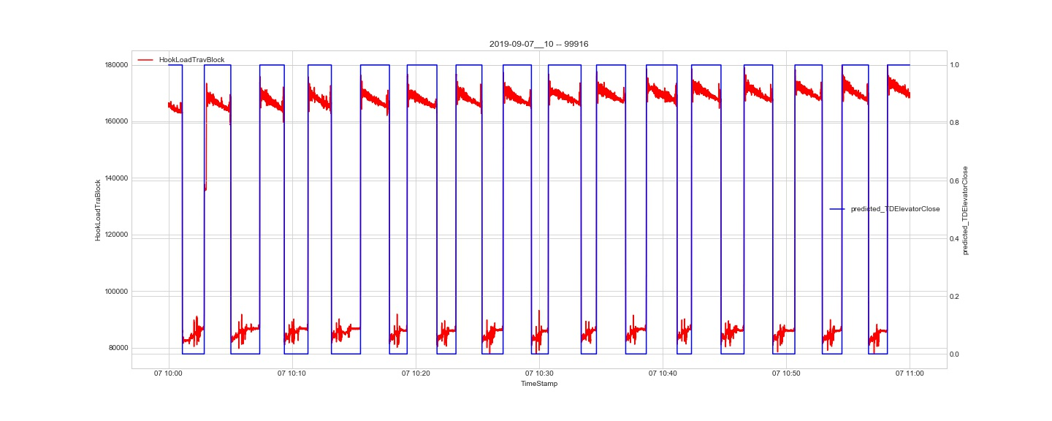
Result

Slide 16
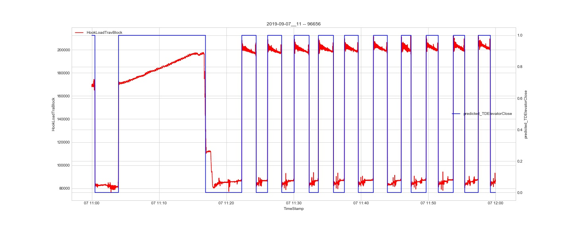
Result

